Slide 1
Python & Hello World
Python Class #1
HEHology

Slide 2
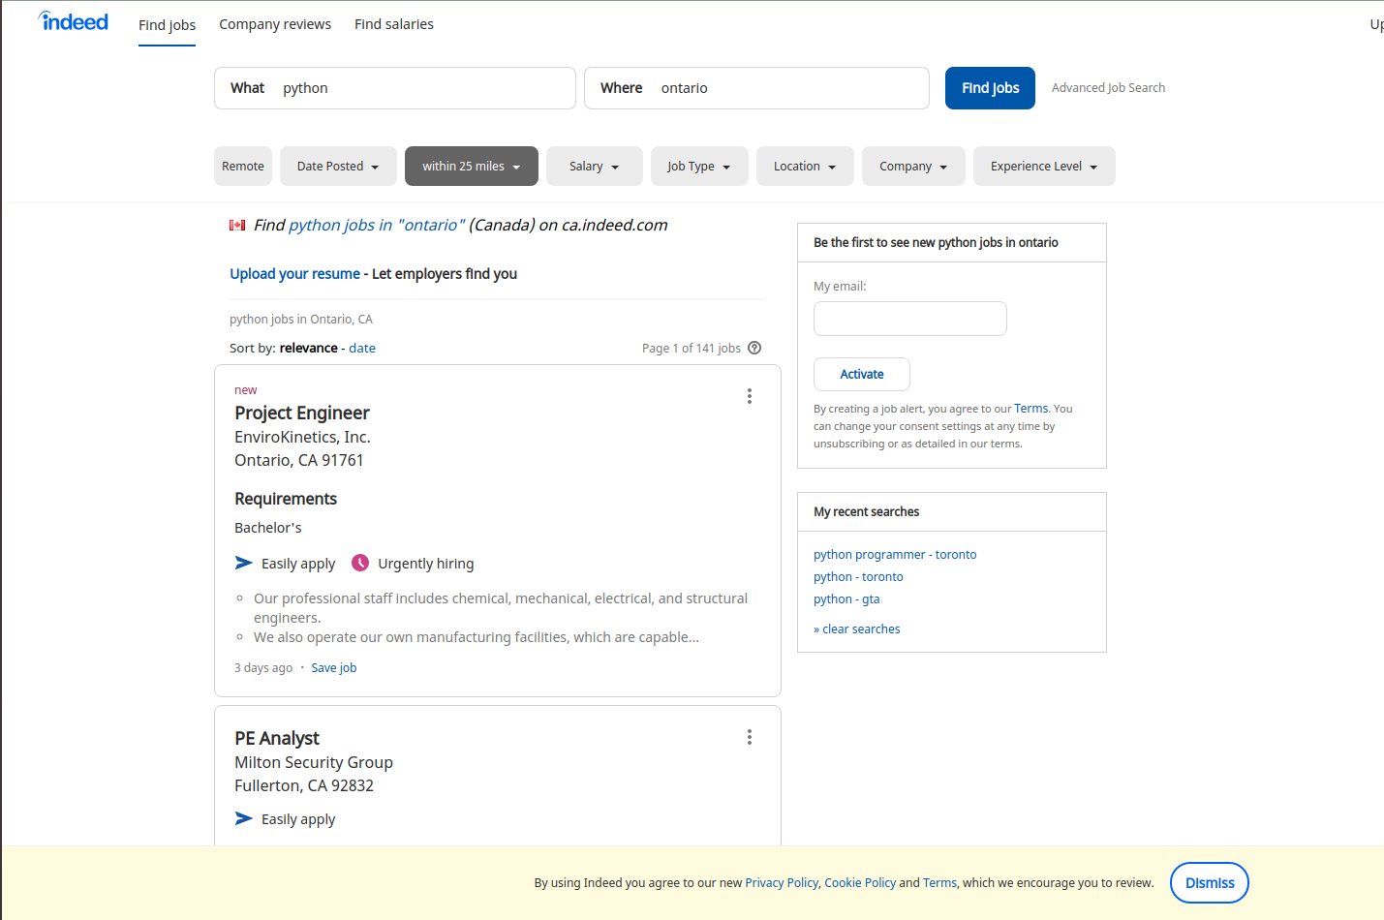
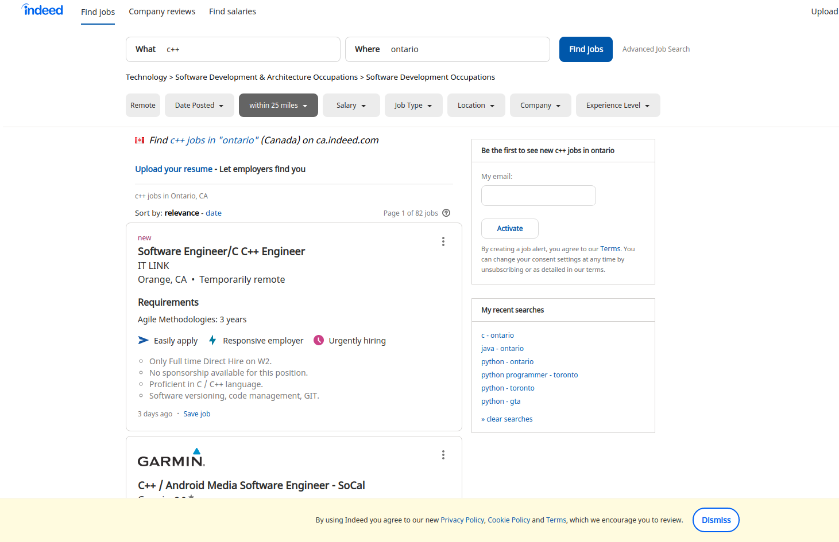
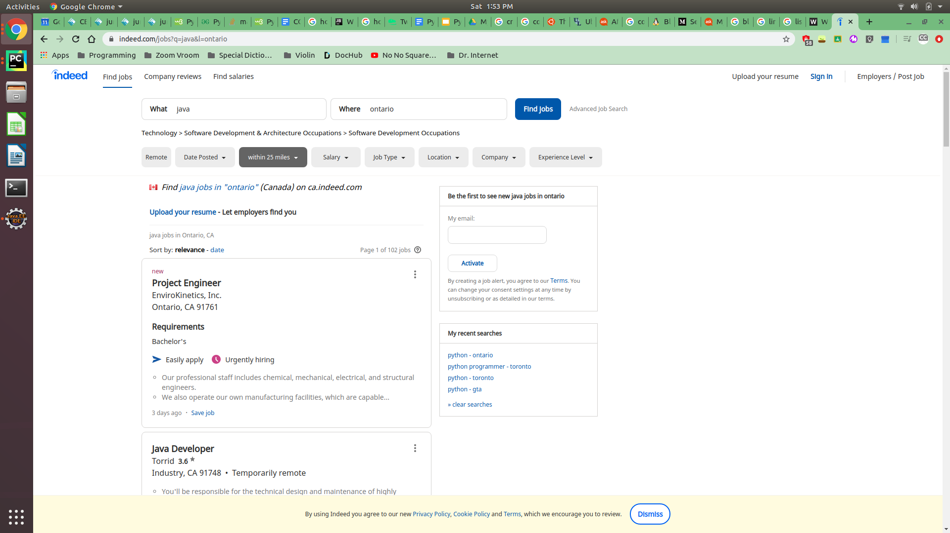

Python
What is Python?
Why is it so popular?
Programming Language
Simplicity
Tons of libraries
What can you do with Python?
Create a website
Calculations
Machine Learning
Web Crawler
Why should we learn Python?
Data mining
Job Opportunities
Practice
HEHology
Notes:
What is Python?
A simple programming language
The most popular language
What can you do with Python?
Website
Google
Youtube
Instagram
Spotify
Netflix
Pinterest
Reddit
Calculations
Addition
Subtraction
Multiplication
Division
Machine Learning
Studying algorithms through machines
Grammarly
Web Crawler
Google’s search results provide the most relevant sites by using crawler
Why is it so popular?
Simplicity
Python is known for its code that is close to human language
Many people prefer Python because it’s easy to learn compared to other languages like C and Java
Libraries
Numpy
Make dimensional arrays
Request
HTTP requests easier
Beautiful Soup
Parse HTML code
Why should we learn Python?
Data mining
To discover patterns in raw data, such as business marketing strategies
Job Opportunities
There are more opportunities in compare to
C++
Java
Python has the most
(reminding during covid very less)
Practice
Decomposition
how to break problems into smaller pieces
Abstraction
how to identify what the critical pieces of information are with a problem

Slide 3
How to install Python
HEHology

Slide 4
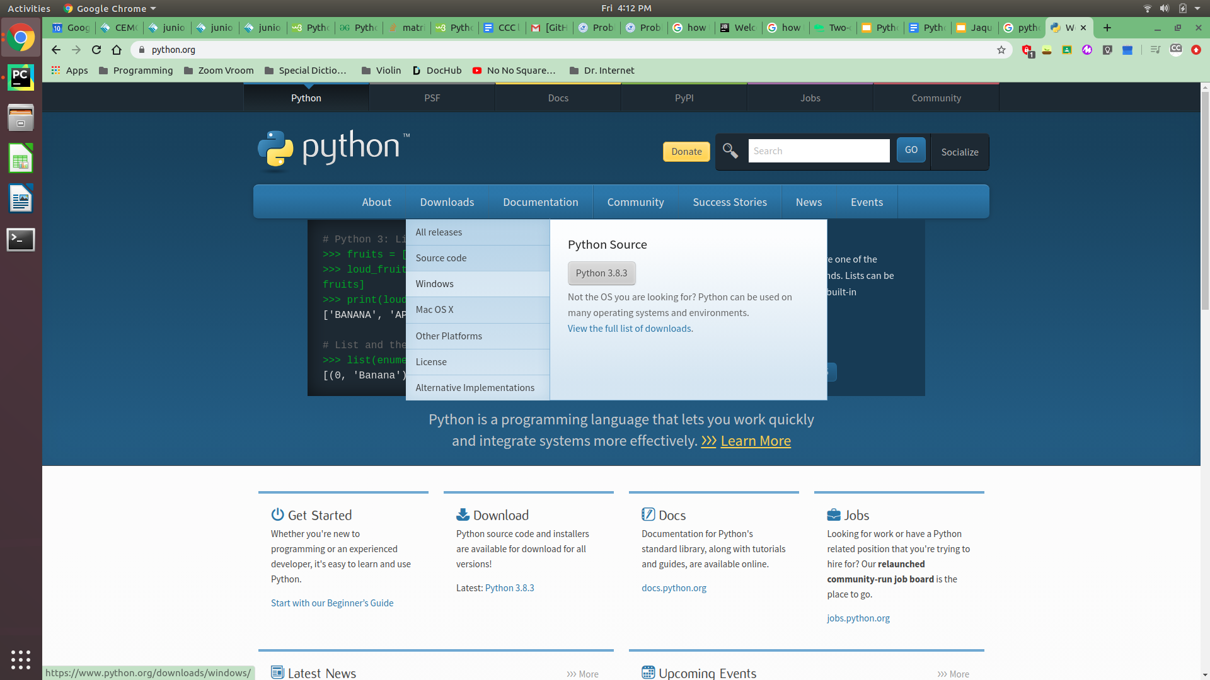
How to install Python
Click on “Windows” in the “Downloads” tab
Go to Python.org
HEHology

Slide 5
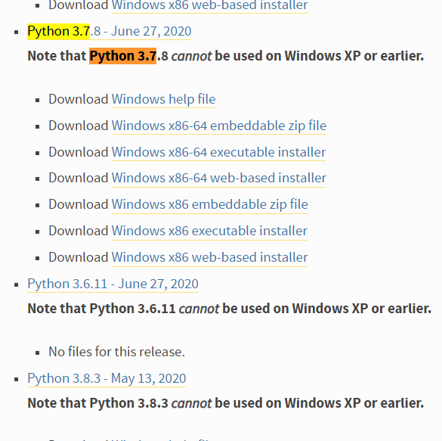
How to install Python
Click on “Download Windows x86 executable installer”
Download “Download Windows x86-64 executable installer” if it is 64 bits
Open “Python” from your downloads bar
HEHology

Slide 6
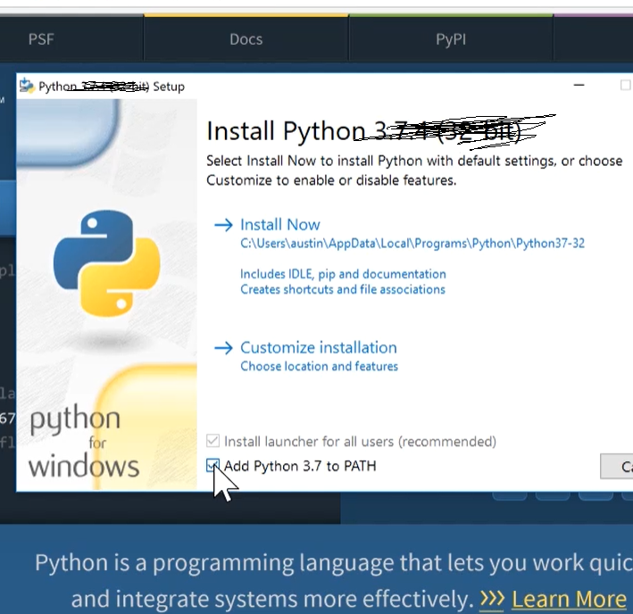
How to install Python
Click “Add Python 3.7 to PATH”
Click “Install Now”
HEHology

Slide 7
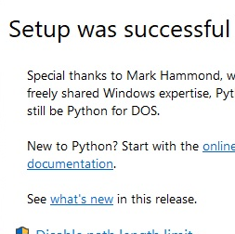
How to install Python
Press “close” on the “Setup was successful” window
HEHology

Slide 8
How to install PyCharm
HEHology
Notes:
This is the ide.
It is an integrated development environment that makes programming easier

Slide 9
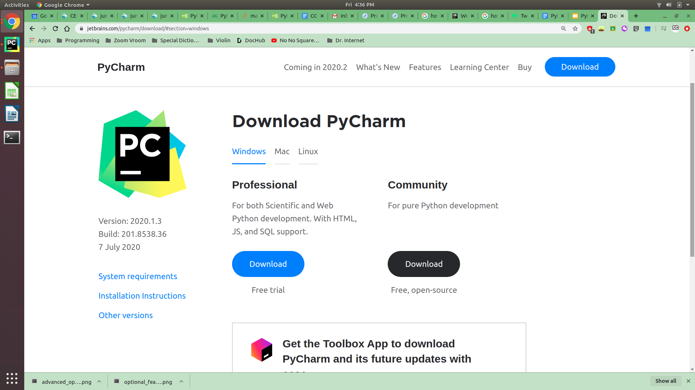
How to install PyCharm
Click on “DOWNLOAD”
On the windows tab, click “Download” under “Community”
Open PyCharm from your downloads bar
Go to jetbrains.com/pycharm/
HEHology

Slide 10
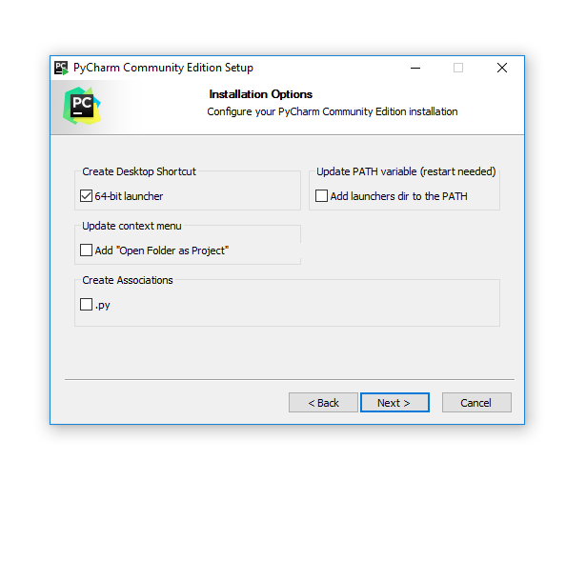
How to install PyCharm
On the PyCharm window, click “Next” on the Welcome page.
Click on “Next” in “Choose Install Location”
Check “Create Desktop Shortcut”
Click “Install” in “Choose Start Menu Folder”
HEHology

Slide 11
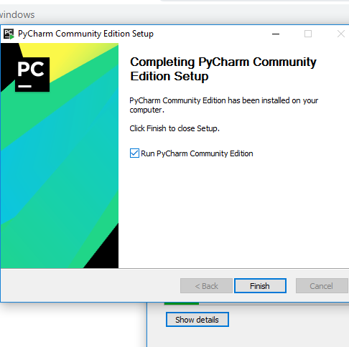
How to install PyCharm
Select “Run” and Finish
HEHology

Slide 12
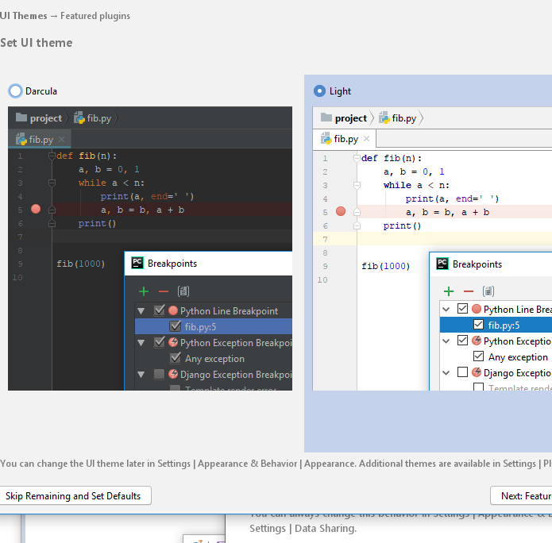
How to run PyCharm
Accept the Jetbrains Privacy Policy
Click “Don’t send” in the Data Sharing window
Choose a UI theme
Click on “Start using PyCharm”
HEHology

Slide 13
Creating New Projects
HEHology

Slide 14
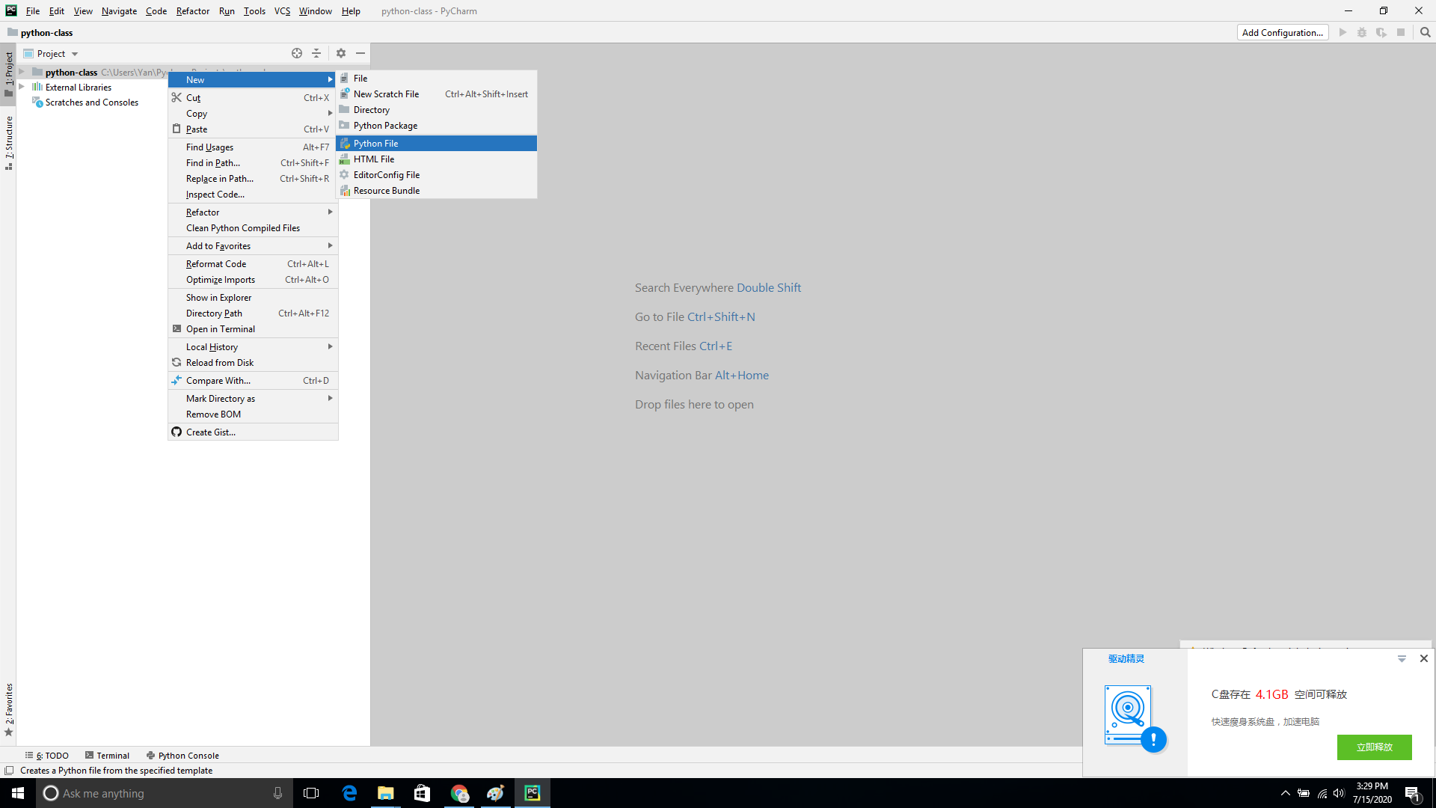
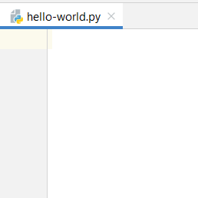
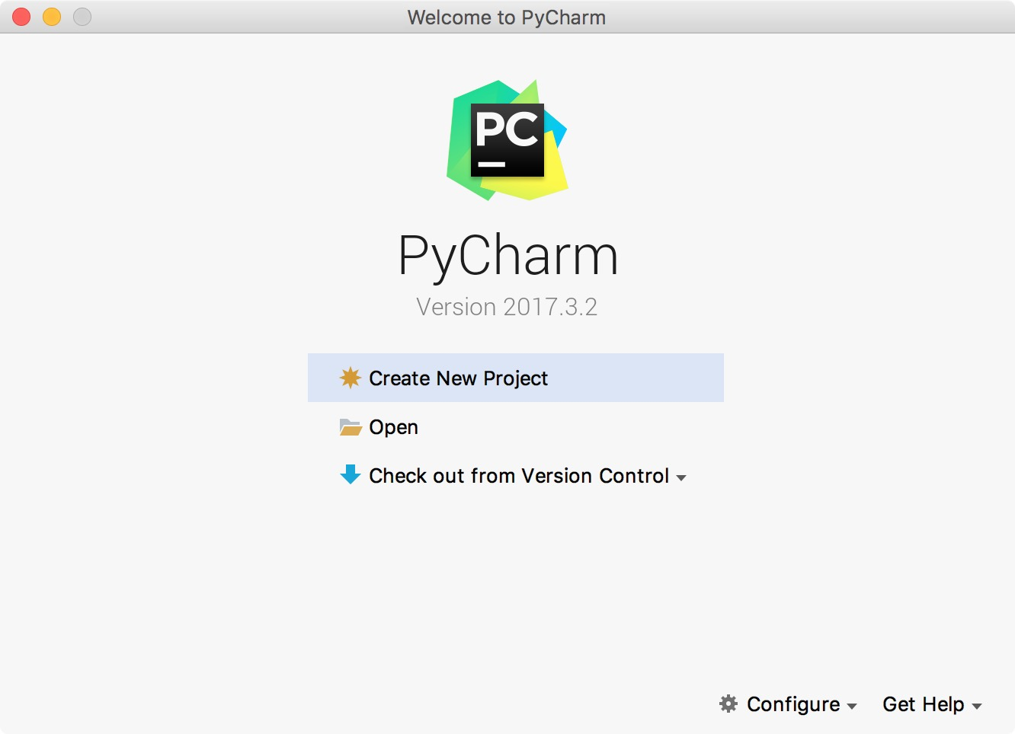
Create new Project
HEHology
Notes:
(show image screenshotpy10)
Since you have no new projects, click “Create New Project”
Normally, go to File/New Project
Name your project
Right-click your created folder, click “Python File” in “New”
Name it something you’ll remember
To run, press Alt Shift F10
Or press Shift F10 for normal running

Slide 15
Hello, World!
HEHology

Slide 16
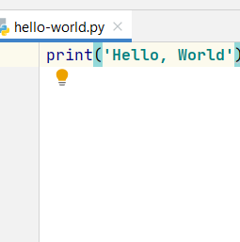
Hello, World!
What is Hello, World?
Why do we learn “Hello, World”?
“Hello, World” is a sample text to print first after setup
Execution
Why use “Hello World”?
Traditions
To run:
Press Alt+Shift+F10
Press Shift+F10 (for normal running)
How to use “Hello, World”?
print(‘Hello, World!’)
print(“Hello, World!”)
HEHology
Notes:
What is Hello, World?
“Hello, World” is a sample text to print first after setup
(why hello world)
Computer scientist, Brian Kernighan, was writing a manual
Nobody really knows why he wrote Hello, World
(other things to print)
You can
This the tradition
Why do we learn “Hello, World”?
Execution
Many processes
Only need to print to know it successful
How to use “Hello, World”?
print(‘Hello, World!’)
print(“Hello, World!”)
(Recommends first one, easier to type)

